Slide 1

Boolean Circuits 1
Instructor: Kuan Cheng

Slide 2
Topics
The circuit model
Complexity Measure: Circuit size
Circuit satisfiability
Size Hierarchy
Karp-Lipton Theorem

Slide 3
Boolean Circuit
A different computational model
Generalizing Boolean formulas and a simplified model of chips, physical running of computers.
A Boolean circuit is a diagram to compute an output from a binary input string.
Computation: applying a sequence of basic Boolean operations: AND, OR, NOT

Slide 4
Boolean Circuit
For any n, an n-input 1-output Boolean circuit is a DAG with n sources and one sink.
All non-source vertices are called gates and labeled with one of ∨, ∧, ¬.
The size of the circuit C, |C| is the # of vertices in it.

Slide 5
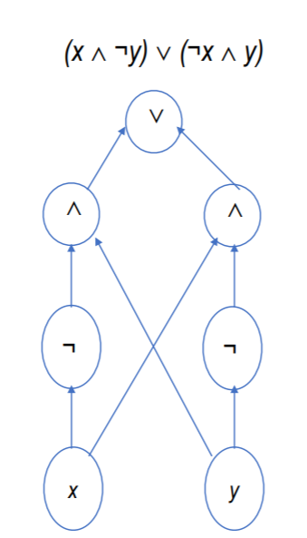

Slide 6
Boolean Circuit
The # of incoming edges to a gate is called fan-in.
For ∨, ∧, fan-in=2; for ¬, fan-in=1
The # of outgoing edges of a gate is called fan-out.
Boolean formulas: fan-out =1;
General circuits: fan-out can be larger than 1.

Slide 7
Boolean Circuit
Boolean circuit is a non-uniform computational model.
TM model: the same TM is used for all possible input sizes.
Boolean circuit family: can have a different circuit for every input size.
Thus, even if P ≠ NP, it is not known whether exists small size (e.g., poly size) circuit family which solves SAT

Slide 8
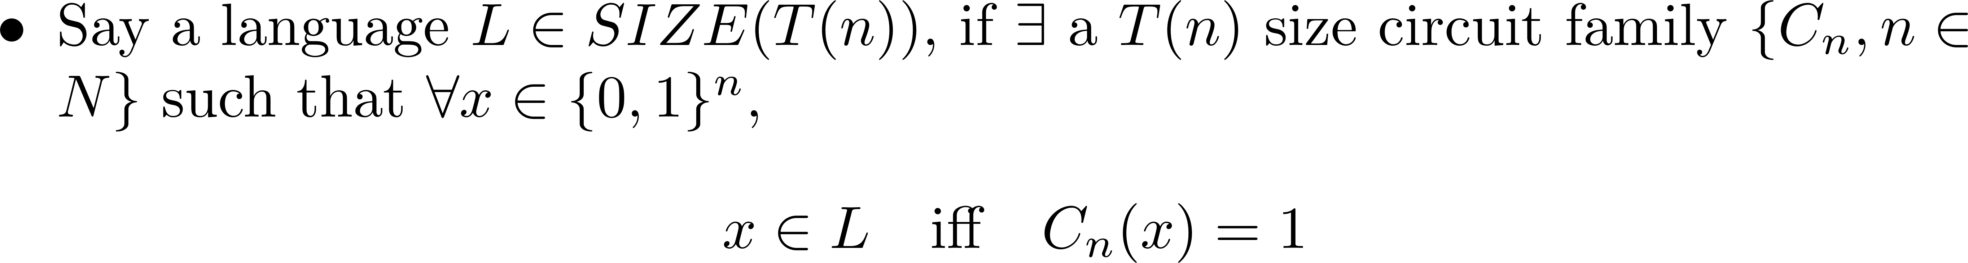
Boolean Circuit

Slide 9
Boolean Circuit

Slide 10
Poly-Size Boolean Circuit

Slide 11
Poly-Size Boolean Circuit

Slide 12

Poly-Size Boolean Circuit

Slide 13
Poly-Size Boolean Circuit

Slide 14
Poly-Size Boolean Circuit

Slide 15
Circuit Satisfiability: A Simple Version of Cook-Levin Theorem

Slide 16

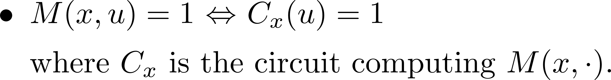
Circuit Satisfiability

Slide 17
Circuit Satisfiability

Slide 18
Circuit Size for a Function

Slide 19
Circuit Size for a Function

Slide 20
Circuit Size for a Function
An intriguring approach to prove P ≠ NP is to show a language in NP that requires super-polynomial circuit size.
However, the best known circuit lower bound for an explicit function/language is only about 3n.
Still very far from proving P ≠ NP

